Slide 1
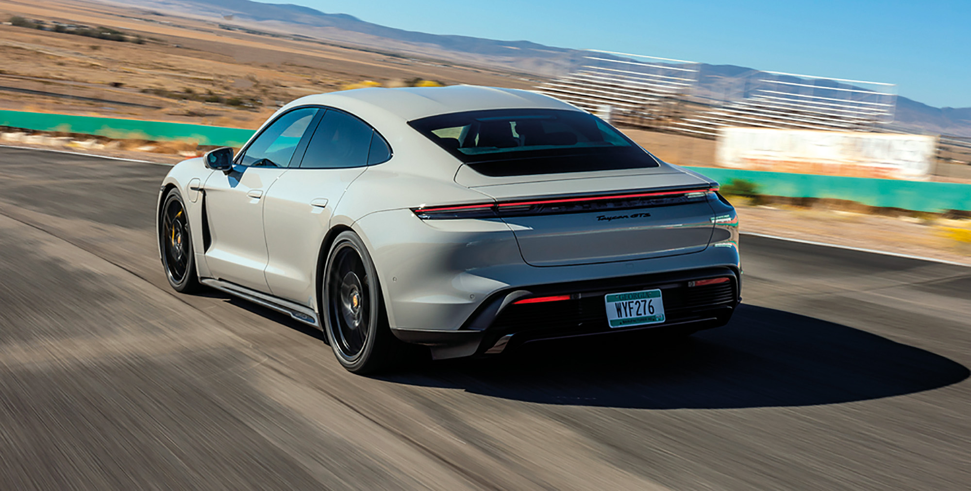
Car price prediction
: Linear Algebra for Data Science

Slide 2

Source Code
https://github.com/natthawit-jan/car_price_prediction_proj

Slide 3
Data
An automobile company wants to predict the car price that the customers are willing to pay for a new car.
Given a few customer features such as age, annual salary and net worth, we can build a linear regression model to predict the expected car price.
Data Source: https://www.kaggle.com/datasets/dev0914sharma/car-purchasing-model

Slide 4
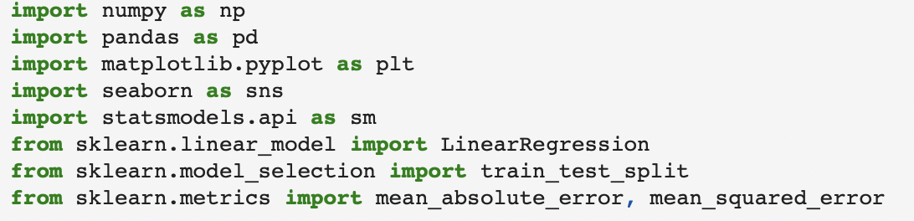
Import Library

Slide 5
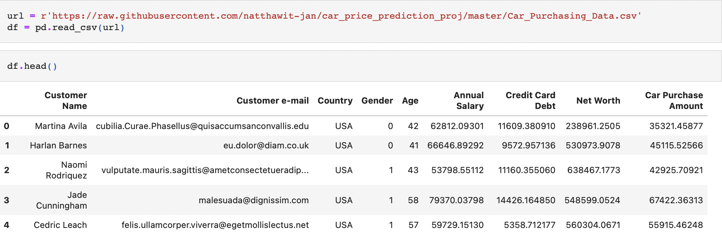
Import Data

Slide 6
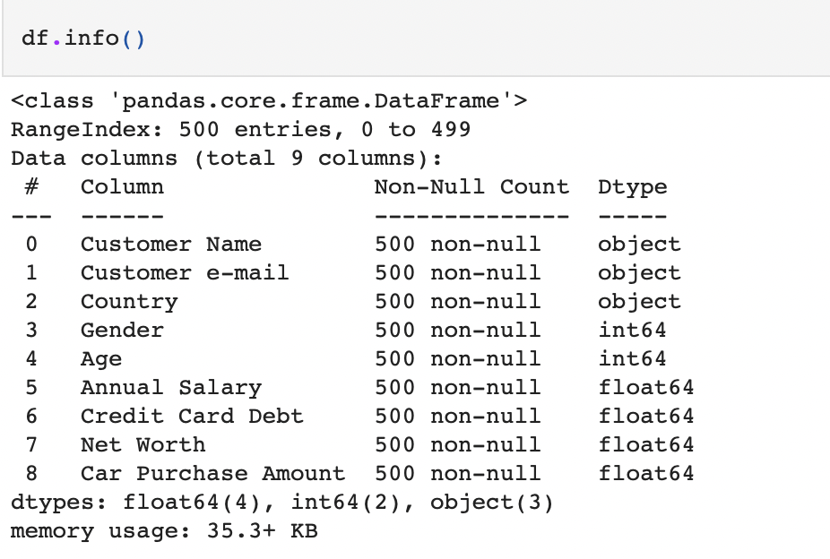
Check Data Missing

Slide 7
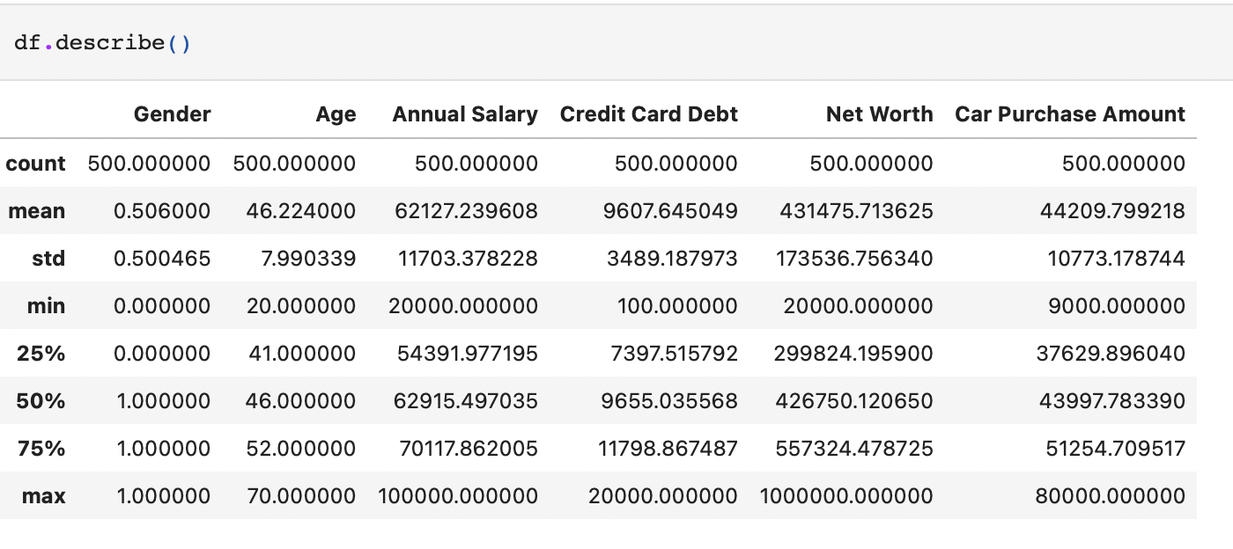
Exploratory Data Analysis
(EDA)

Slide 8
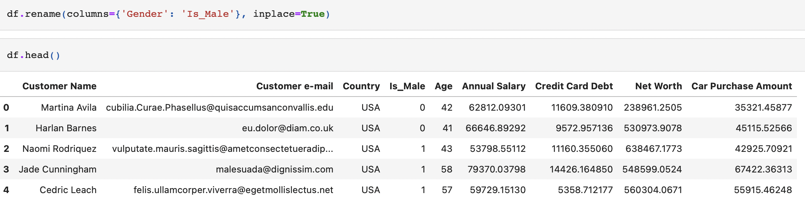
Data Preparation
Rename the column of gender to is_male, where 1 indicates male and female otherwise

Slide 9
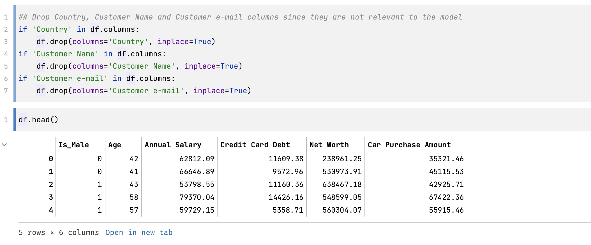
Data Preparation (remove columns)
Drop Country, Customer Name and Customer e-mail columns

Slide 10
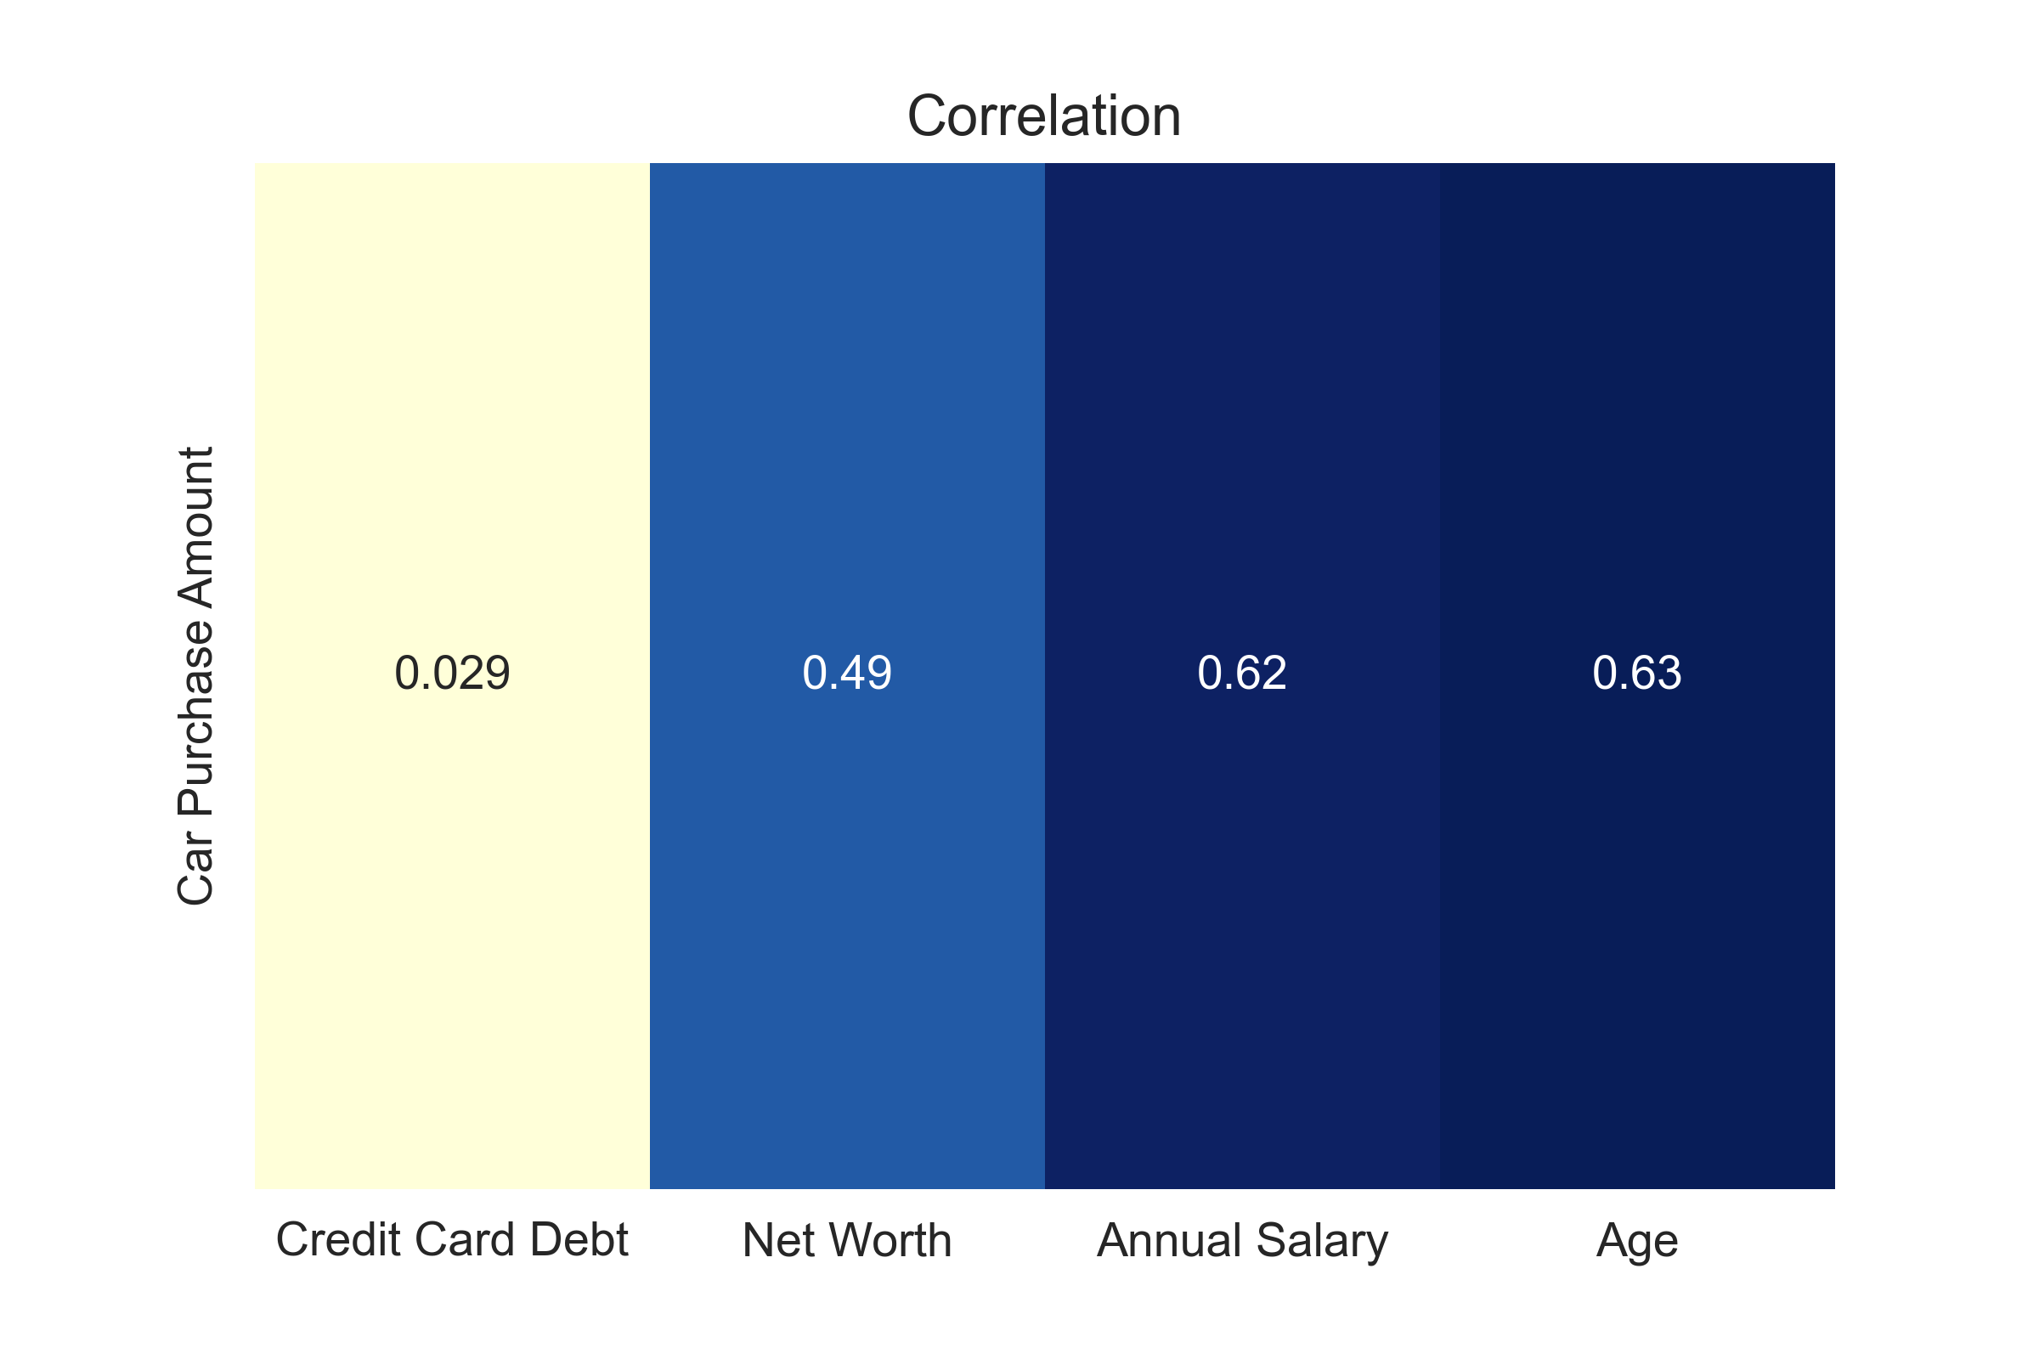
Correlation Heat Map

Slide 11
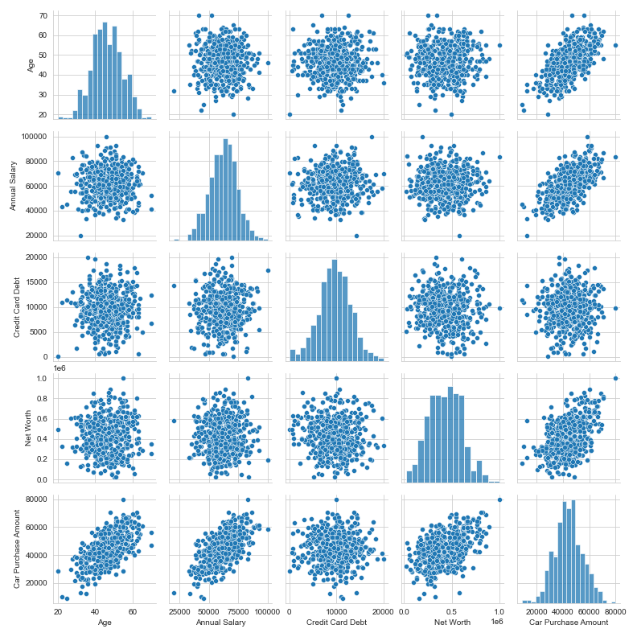
Finding Correlation
between X and Y

Slide 12
Correlation of 3 linear features

Slide 13
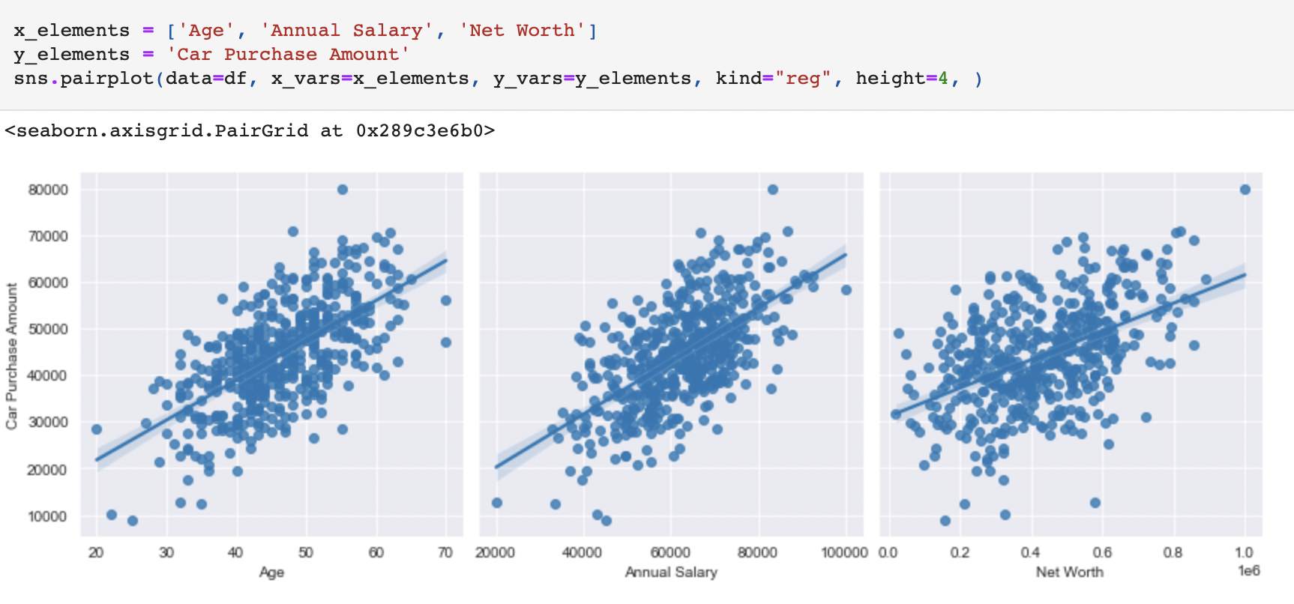
Regression plots for 3 linear features
Therefore, looking from the plots, we can see that there are mainly 3 features that look linear and can be used to train the model. Age, Net Worth and Annual Salary.

Slide 14
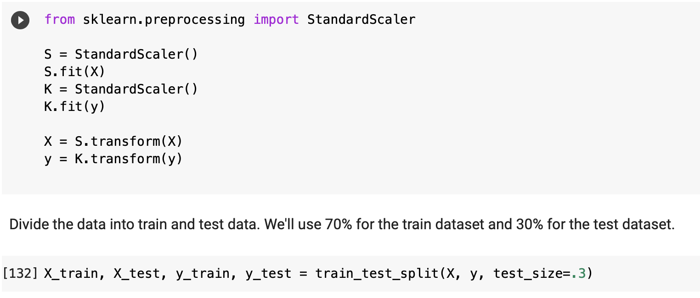
Standardize and Split Data

Slide 15

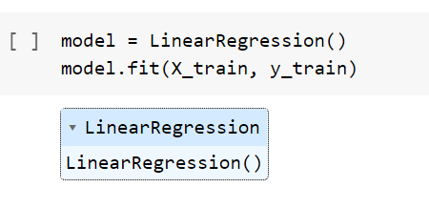
Import Linear Regression model + train data

Slide 16
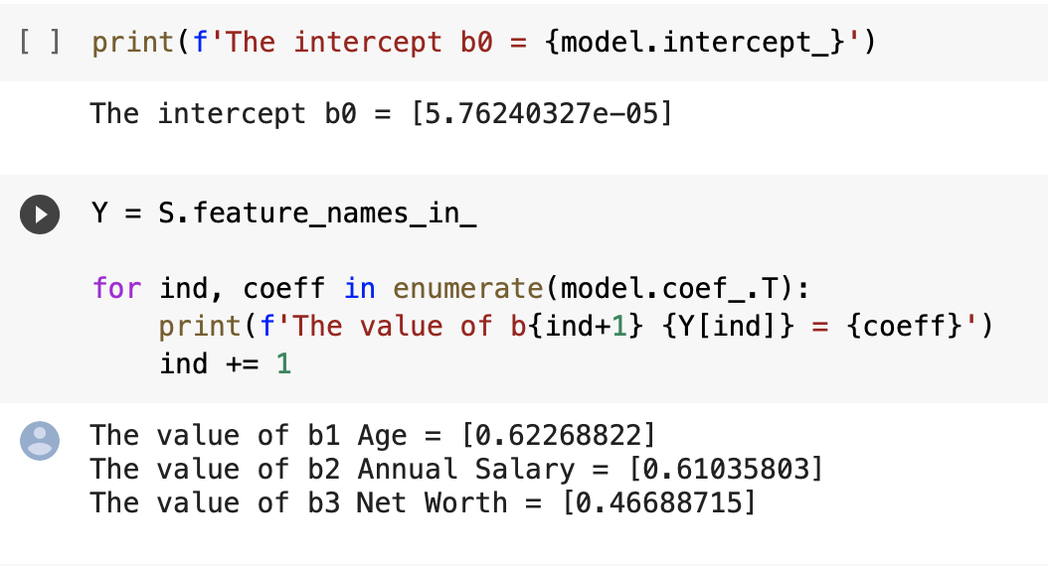
Get all coefficients from the trained model

Slide 17

The regression equation
If `Age` goes up by 1 unit, the car price will also go up by 0.62
If `Annual Salary` goes up by 1 unit, the car price will also go up by 0.61
If `Net worth` goes up by 1 unit, the car price will also go up by 0.47

Slide 18
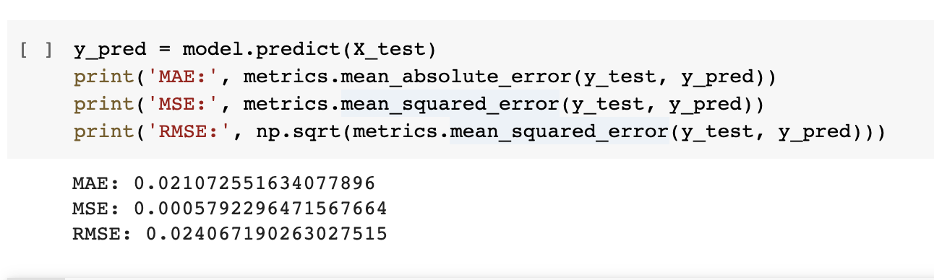
Predict the outcome with test data + Calculate error

Slide 19
From the RMSE result, our model in general can be wrong by 0.024 (std.) ( around 44,000 dollars off )

Slide 20
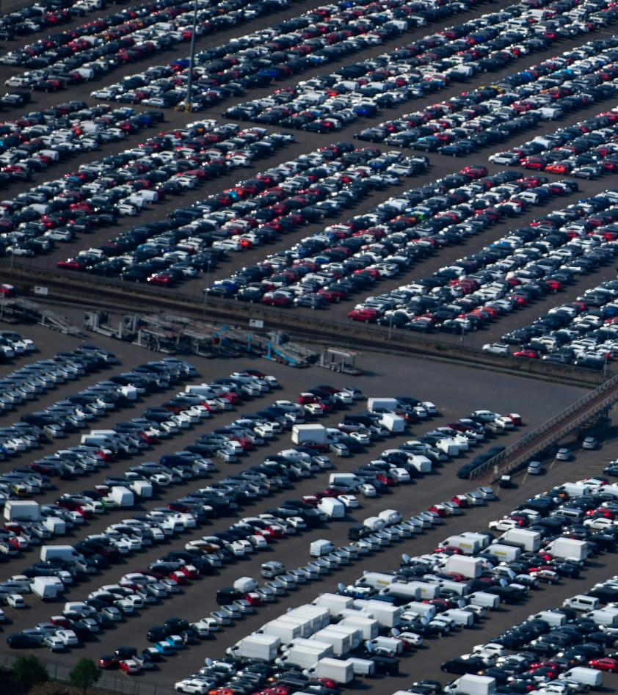
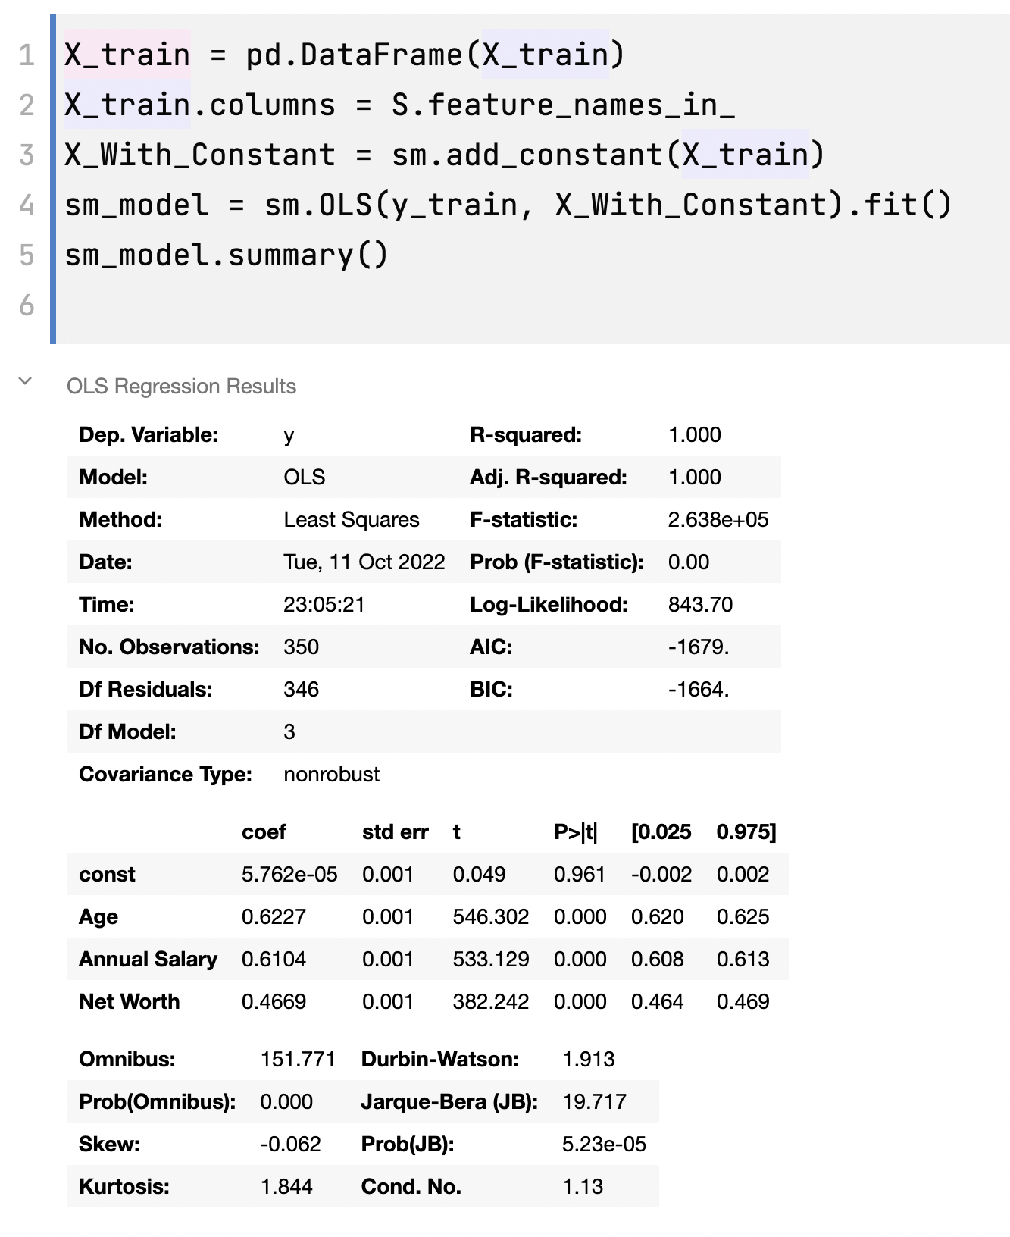
ANOVA TABLE
(Analysis of Variance)

